Slide 1
Penetration Testing with Kali Linux
Simon Owens
SEIT MSM Cybersecurity Engineer
Notes:
Text or image elements are not permitted below the copyright or takeaway bar on any slide to allow this white space for required document markings.

Slide 2
What will we cover?
Course Review
Skillset Gained
Penetration Testing Methodology (flow chart)
Enumeration
Exploitation
Privilege Escalation
Reporting
Walkthrough
Exploitation Process
Resulting report
Future Work
Avionics products/systems
Applications
Lab Environments

Slide 3
Course Review
Pros
Real life experience/performance based
Develop Pentesting/troubleshooting process for attacking system’s
You will never run out of material unless you spend 500 hours or are really good
Cons
Lack of Time
Sufferance (good for millennials?..)

Slide 4

TFS Burn Down

Slide 5

TFS Burn Down

Slide 6
Course Info
Table of Contents
Getting Comfortable with Kali Linux
Essential Tools
Passive Information Gathering
Active Information Gathering
Vulnerability Scanning
Buffer Overflows
Windows Buffer Overflows
Linux Buffer Overflows
Working with Exploits
File Transfers
Privilege Escalation
Client Side Attacks
Web Application Attacks
Password Attacks
Metasploit Framework
Bypassing Antivirus Software

Slide 7
Skillset Gained
Penetration Testing Process
Penetration Testing Report
Executive Summary
Concisely Describe process
Heavy emphasis on: What do I have to fix? What can I fix? What fixes what?
Network Enumeration and exploitation
System Level Enumeration and exploitation
Exploit Development and Modification
Web Application (basic)
Avoiding AV, bypassing firewalls(host and network), pivoting to other systems

Slide 8
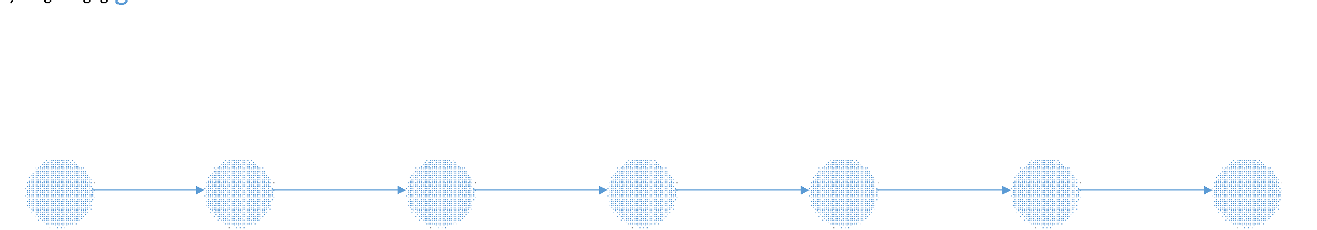
Penetration Testing Methodology

Slide 9
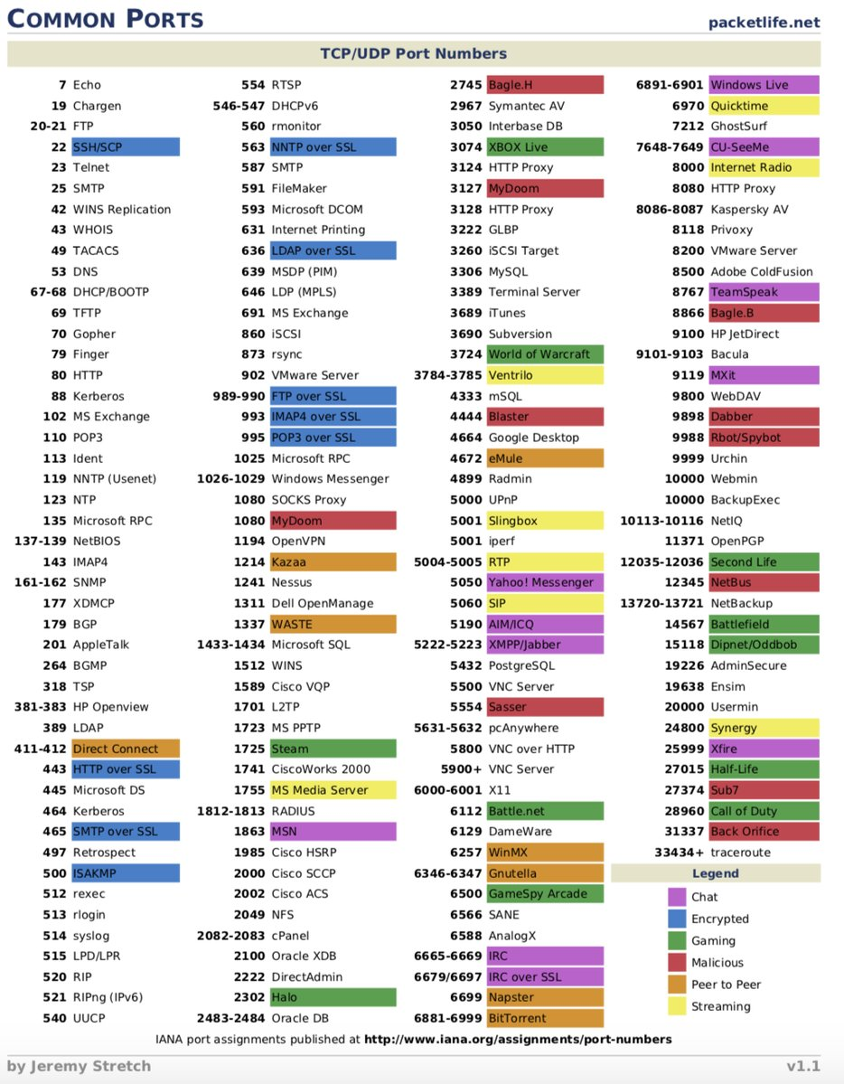
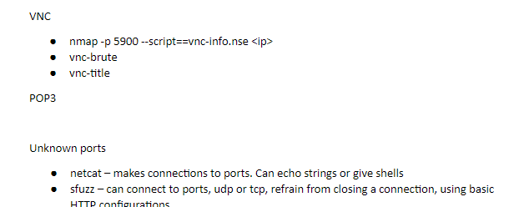
Networking Scanning
Perform a light scan first to see wut up
Perform a heavy scan while enumerating open ports
Enumerate each service – attack low hanging fruit first
What version is running?
What are user’s that can access that share?
Can commands be executed through this protocol?
Can code be placed on the machine through this protocol?
What tools can be used to enumerate this service?

Slide 10
Enumeration
What is the purpose of this system?
What is the OS/Architecture of this system?
What users/groups/policies are on the system?
How can I place code on the system?
How can I execute code on the system?
Can I break anything from enumerate/exploiting system?

Slide 11
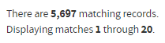
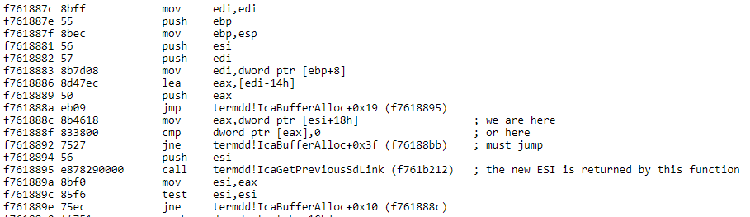
Rabbit Holes
Nearly every application has “associated vulnerabilities/CVEs” with every release but they are all not worth your time

Slide 12
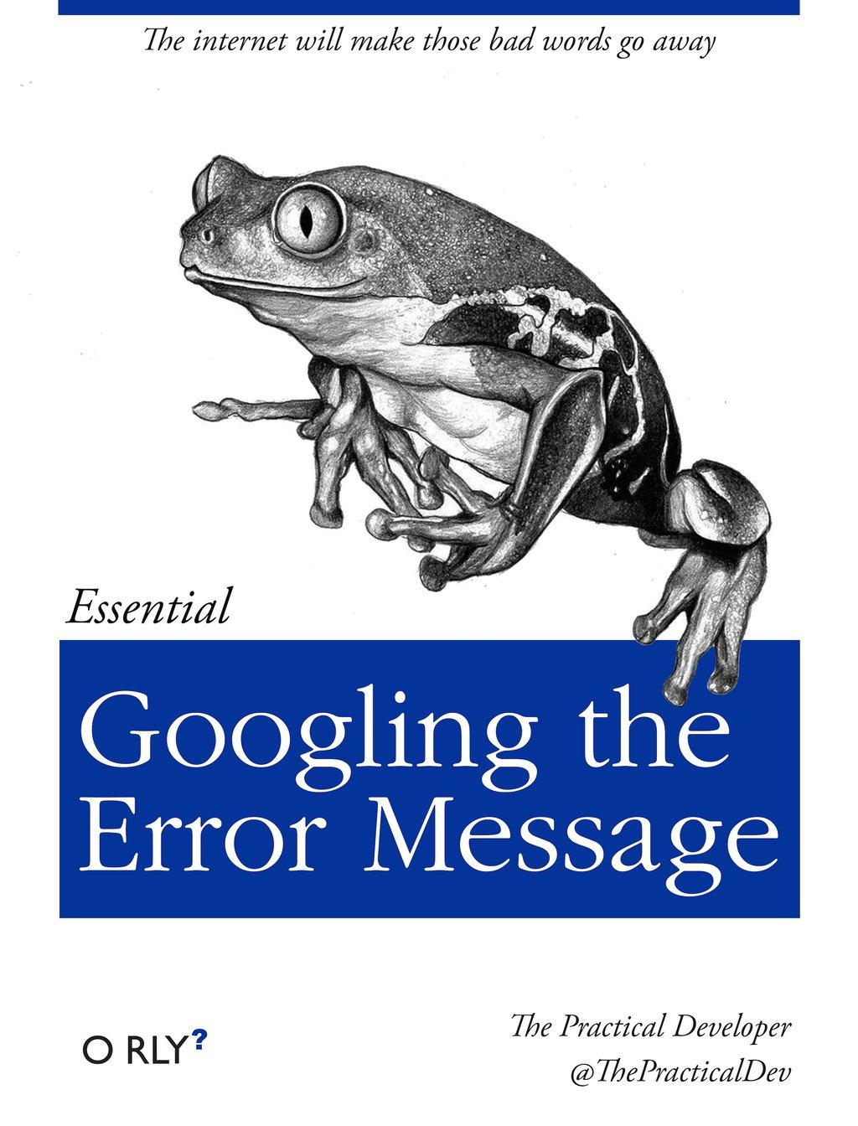


Rabbit Holes

Slide 13
Exploitation
It is very easy to go down a rabbit hole of trying to enumerate/exploit a system
It is very tempting for people to find what they think is a vulnerable service and then try to fire off all Metasploit exploits on it…

Slide 14

Exploitation failures…
You just nuked the entire town and now you are wondering why they don’t talk back when you say things to them….

Slide 15
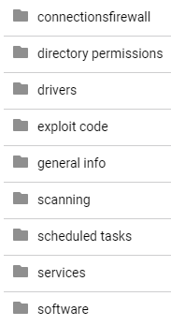
Enumeration and Exploitation
It is easy to become overwhelmed by all of the running services and information you collected. You must have a meticulous process for enumerating before you attempt exploitation. Enumerate the entire system first and see if anything alarms you first.
Lists
To do
Done
Usernames/passwords
Problems

Slide 16
Exploitation
Again enumerate well… it’s ok and expect to re-enumerate services
Enumerate Lightly
Document information in template (OS, users, services, etc)
See if any low hanging fruit
Find exploit to fix system
Understand how it breaks the targeted service
Understand what it tries to do or execute
Make sure it is compatible with OS/Arch/Language
Understand how you get a reverse shell back
Eat a piece of candy as a reward

Slide 17

You got access!

Slide 18

Just a low privileged shell…

Slide 19
Privilege Escalation
First of all I am still learning all of the many aspects of privilege escalation locally on a machine… its hard
Services
Startup Tasks
Files/Directory Permissions
Sticky Bit Files
User processes
Kernel/OS exploits
Software/Driver exploits

Slide 20
Privilege Escalation
Same process as network enumeration…
I developed scripts to enumerate the system for me and query exploit-db to potentially match them to exploits… my scripts are around 70pages long total…

Slide 21
Reporting
Executive Summary
Scope
Assessment
Points of Contact
Environment
Tools and Techniques
Discovery and Exploitation Strategies
Findings and Observations
Network Enumeration
File System Enumeration
Physical Enumeration
CVEs
Most Concerning Weaknesses
Exploitation Evidence and Risks
Exploitation Vector 1
Exploitation Vector n…
Recommended Remediation Actions
Fixes for Vector 1
Fixes for Vector n…
Conclusions and Recommendations
Summary
Required Remediation Actions
Additional Testing

Slide 22

Walkthrough
Read my walkthroughs or talk to me in person another time… to accurately go into more detail about my thought process and methods on a pentest would probably take 1-3 hours

Slide 23
Training for Work
Why do we need to be trained how to write/develop/edit exploits if we can just use Metasploit and Nessus?
Number of Exploits
Compliance is a subset of Security (but use compliance as much as possible)
May not be able to implement compliance… how does an attacker take advantage of this flaw, how serious is it, and how can we fix it
Identify severity more accurately by identifying if there are exploits
Tools don’t work/miss things
Nearly every time it doesn’t work out of the box
Testing internally developed things (news flash: no FOSS exploits for these)

Slide 24

Future Goals?
After taking OSCP I’d love to pass in the next year and then take OSCE full time for a month after I graduate
Participate in CTFs with team and at cons

Slide 25
Closing Remarks
Produced
Pentest report with walkthroughs
All exercises completed
Pentest cheat sheet
Windows/Linux information gathering scripts
Windows/Linux exploit checker scripts
It was an exhausting but awesome experience. I’d love to share more of what I’ve learned and help others out

